Slide 1
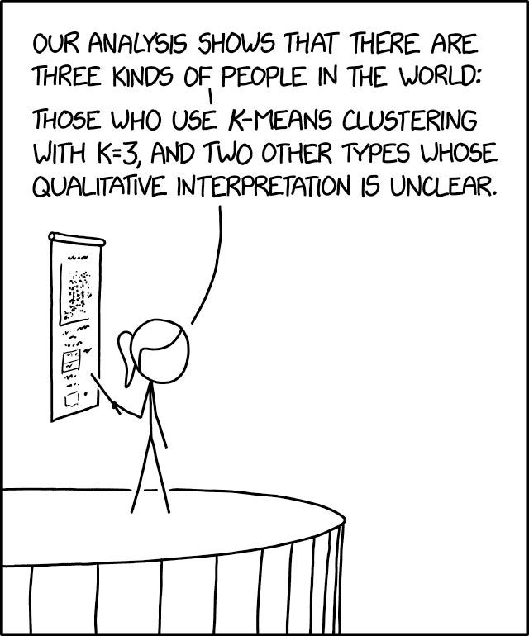
Gaussian Mixture Models and their training with the EM algorithm
Gosztolya Gábor
Szegedi Tudományegyetem
Informatikai Intézet
2023 / Mar / 16

Slide 2
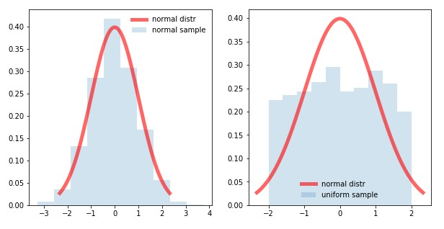
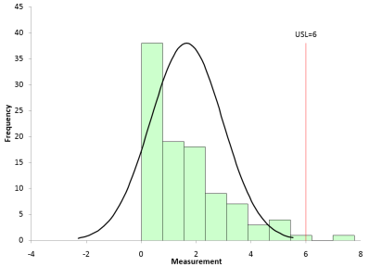
Introduction
We saw how to fit Gaussian curves on data samples
But the Gaussian curve as a model is not really a flexible
The distribution of real data rarely have a Gaussian shape
So the “model error” will be large
Today we introduce a new model called the Gaussian Mixture Model
It has a much more flexible shape than a simple Gaussian

Slide 3
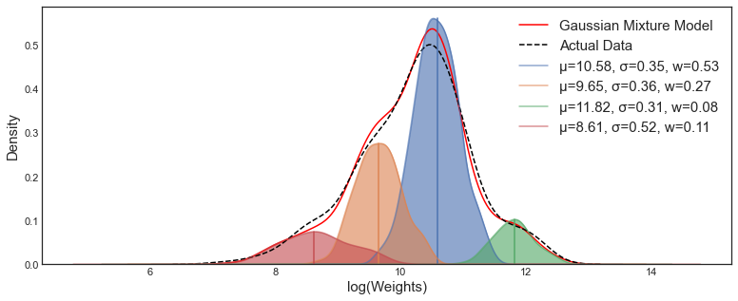
Introduction #2
Unfortunately, training a GMM is more difficult
We will use the Maximum likelihood target function, just as before
But, instead of a closed form solution, we will introduce an iterative algorithm to optimize its parameters. This will be the EM algorithm
We will again train the model of the different classes separately
So we will talk about how to fit the model on the samples of one class, and drop the condition c_{i} from the notation
But don’t forget that the process should be repeated for all classes

Slide 4
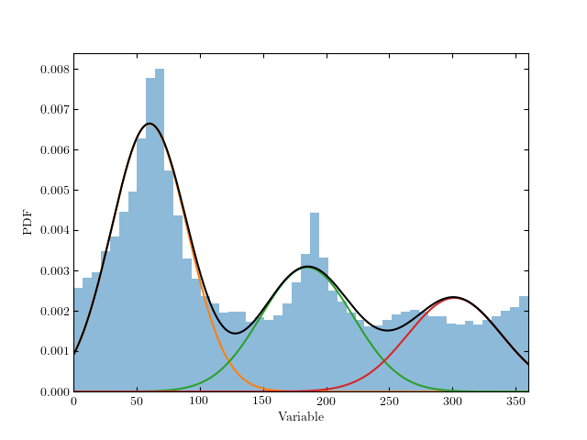
The Gaussian Mixture Model (GMM)
We will estimate p(x) as a weighted sum of Gaussian
Formally:
Where N denotes the normal (Gaussian) distr.
The π_{k} weights are non-negative and add up to 1
The number K of the Gaussians is fixed, we have to specify it before training (so it is a “metaparameter”)
By increasing the number of components, the curve defined by the mixture model can take basically any shape
So it is much more flexible than just one Gaussian

Slide 5
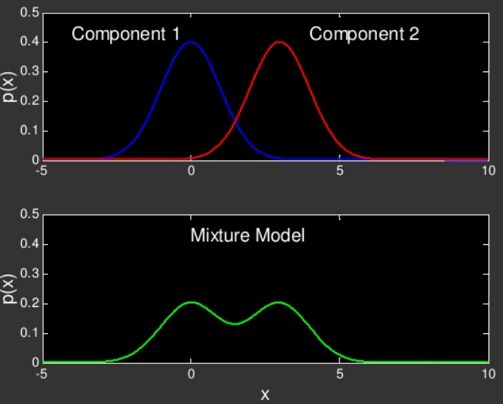
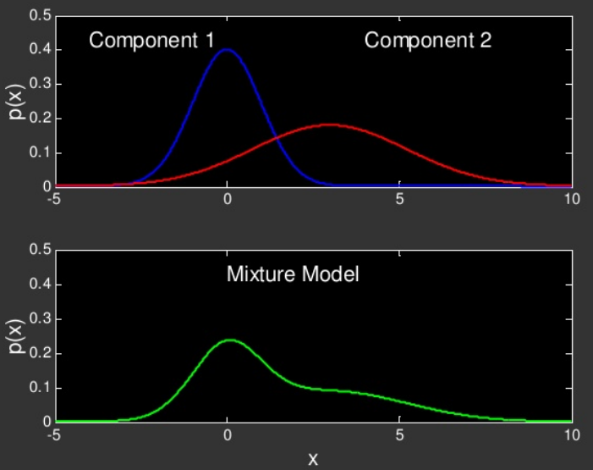
Gaussian Mixture Model (GMM) examples

Slide 6
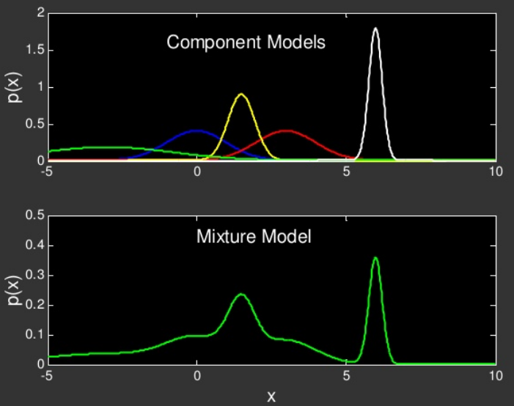
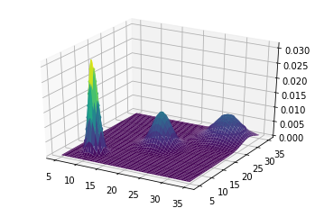
Gaussian Mixture Model (GMM) examples

Slide 7
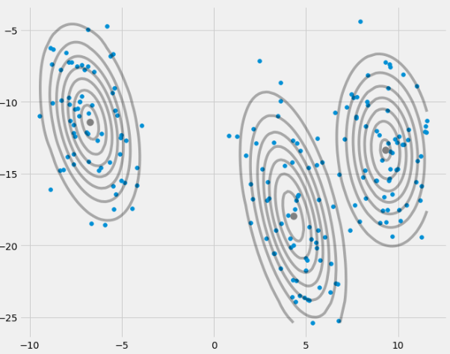
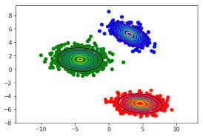
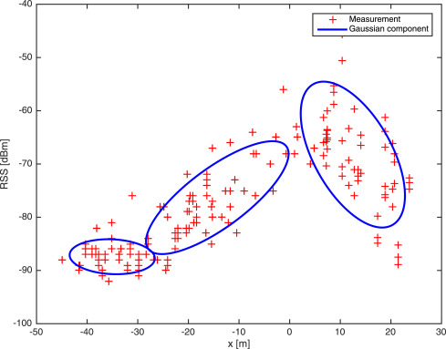
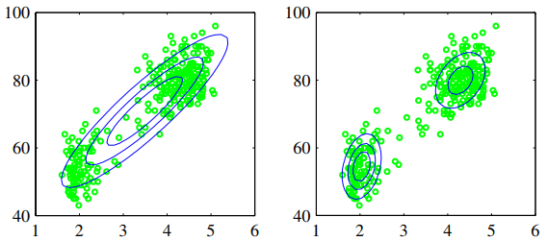
Gaussian Mixture Model (GMM) examples

Slide 8
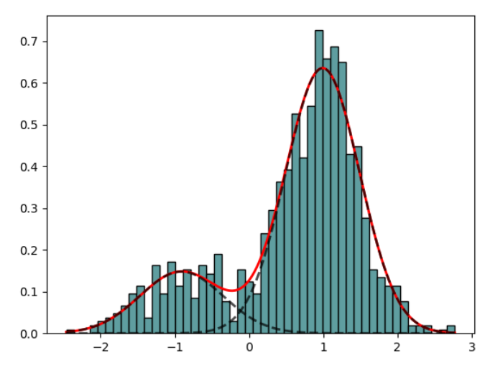
Parameter estimation for GMMs
Model parameters are π_{k}, μ_{k} and Σ_{k} for all components (k=1,…,K).
Sometimes we again use a short notation θ for all the parameters: θ = (π₁, μ₁, Σ₁,…, π_{K}, μ_{K}, Σ_{K})
We again seek to maximize the log-likelihood function:
When p(x) was just a Gaussian curve, we could simply take its derivative and find its zero point
Unfortunately, we cannot take the derivative now
So we will need some other solution – this will be the EM algorithm

Slide 9
Parameter estimation for GMMs #2
Let’s take the log-likelihood function:
And try to set its derivative to zero (e.g. with respect to μ_{k}):
For just one Gaussian, the logarithm helped get rid of exponential
But now there is a summation between the logarithm and the exp
This is the problem (it contains μ_{k}-t)
Derivative of 1 Gaussian (same as before)

Slide 10
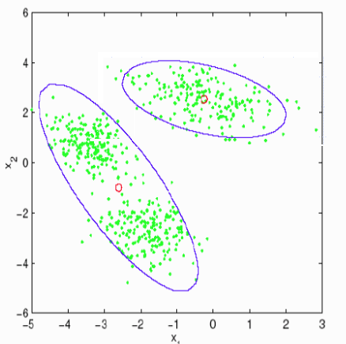
Alternative approach
Let’s divide the samples into disjunct groups
Example: we want to fit a mixture of 2 Gaussians on the green points
Let’s divide the points into 2 disjunct groups (clusters) – see the purple curves
We can perform this division using e.g. the K-means clustering algorithm
We can now easily fit 1-1 Gaussian on both clusters!
Using the ML method seen in the previous lecture

Slide 11
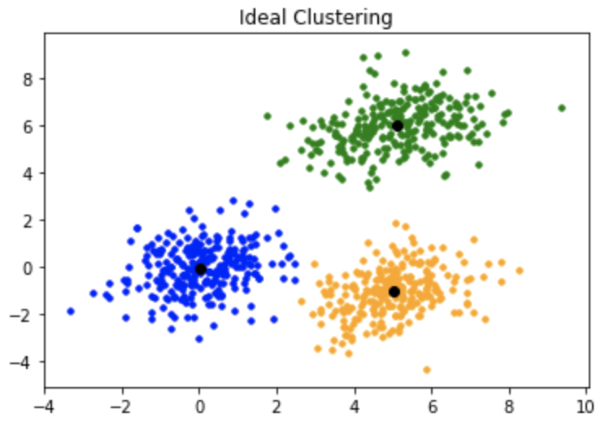
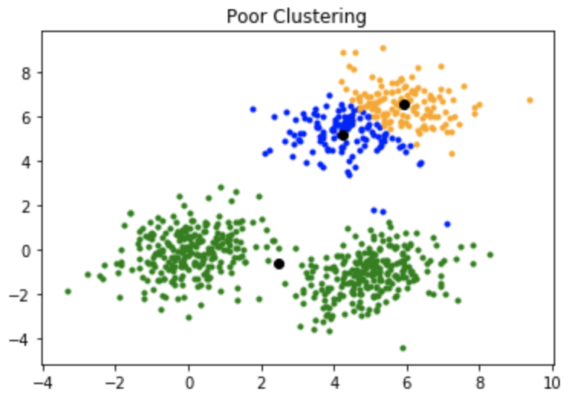
The K-means algorithm
The most common clustering algorithm
Each cluster will be represented by a centroid (i.e. the center of the cluster)
Inputs:
the data points to be clustered
the number of clusters K
A distance functions between the points
(e.g. Euclidean, but we can use others as well: Manhattan, Kullback-Leibler…)
An iterative method

Slide 12
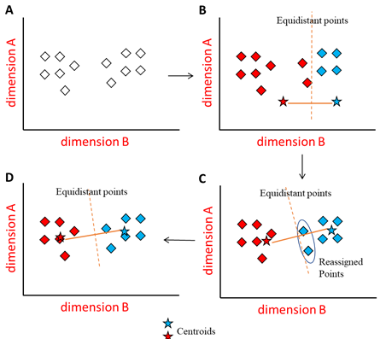
The steps of K-means
1) select K data points randomly as the cluster centroids
2) For each data point find it cluster (i.e. the nearest centroid)
Because we have a distance function for the points!
3) Re-calculate the centroids as the mean of the data points belonging to the cluster
4) If no point changed its cluster: STOP; else GOTO 2

Slide 13
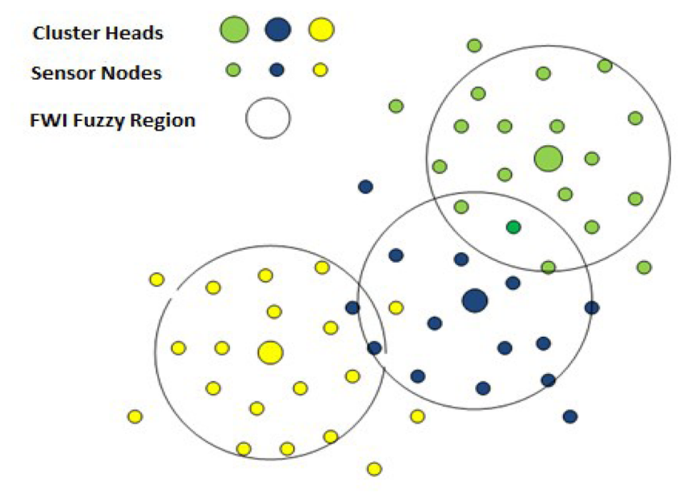
Replacing K-means by “soft clustering”
K-means assigns each data point to exactly one cluster
But the Gaussain curves take >0 values everywhere – so each point belongs to each Gaussian to a certain extent
Instead of K-means, we will use a clustering agorithm that assigns each point to each cluster, but with different weights (“soft clustering”)

Slide 14
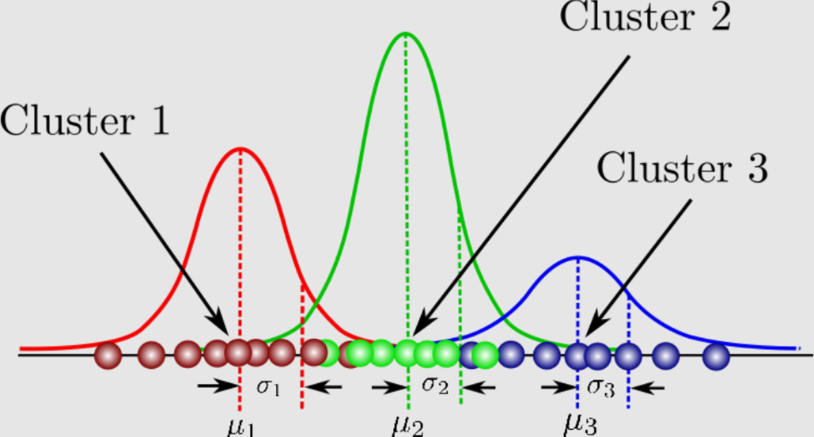
“Soft clustering” during fitting GMMs
Each point will belong to each cluster, but with a different weight
We change fitting the Gaussians to take all the points into account
But: with a different weight!
The weights will be from the [0,1] interval, expressing how much a given points belongs to the given Gaussian
This weight will be denoted by z_{nk} and it will be called the „responsibility” of the kth Gaussian for x_{n}

Slide 15
Fitting a Gaussian curve with involving the weights
We modify the likelihood function of the kth Gaussian
Before: After:
z_{nk} =1: for points with this weight the formula is the same
z_{nk} =0: the given point is ignored
This way, the log-likelihood is also changed:
Before: (summation of the logP values)
After: (weighted summation of the logP values)

Slide 16
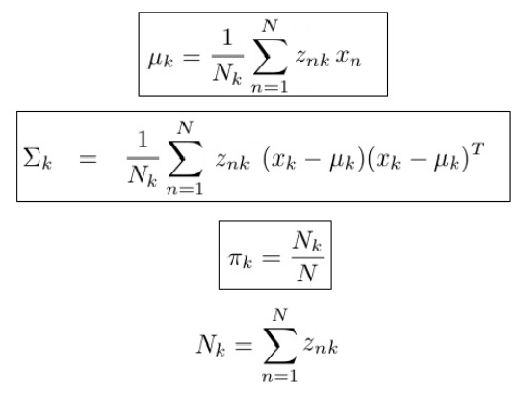
The parameter update formulas
We can also calculate the zero point of the derivative of the log-likelihood
Notice the similarity to the solution obtained for 1 Gaussian
…only now, instead of summation, we have a weighted summation
Easy to calculate, if we know all the z_{nk} values

Slide 17
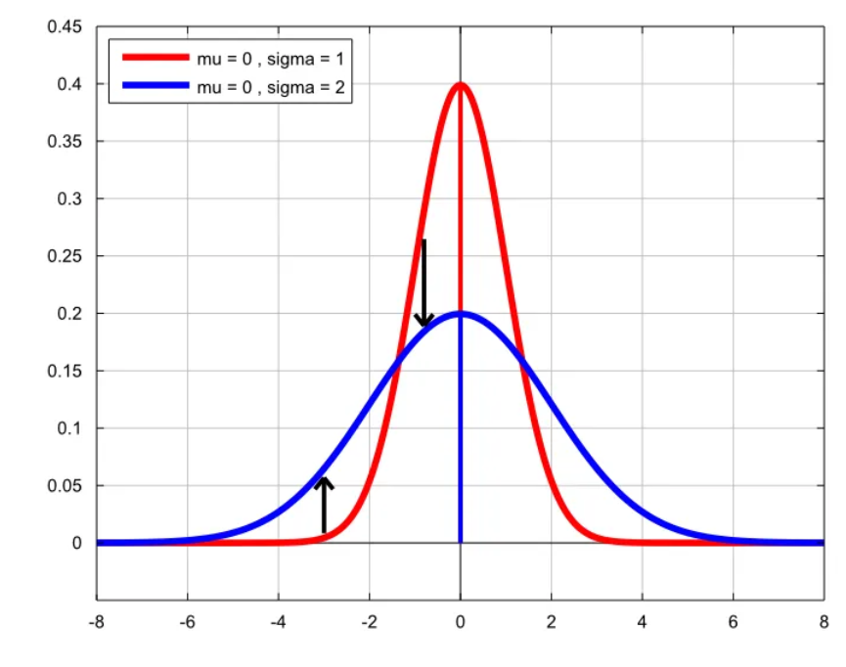
Calculating the responsibility values
We wold need a soft clustering algorithm
But from given Gaussian curves we could also calculate the z_{nk} weights
The z_{nk} ”responsibility” values express how much a point x_{n} belongs to the kth Gaussian

Slide 18
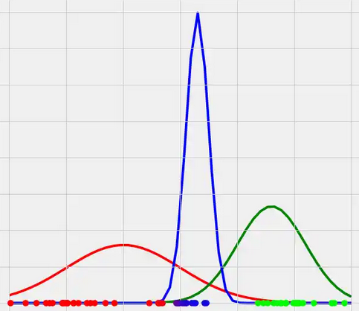
Calculating the responsibility values #2
We can formalize this as
This is simply the likelihood of the k-th Gaussian
Which is divided by the likelihood of the full model just to normalize it to the [0,1] range
So the Gaussian components themselves define a soft clustering
…if we know the Gaussians, that is, the values of the μ_{k} and Σ_{k} parameters!

Slide 19
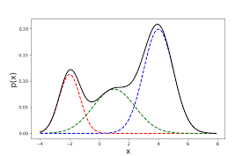
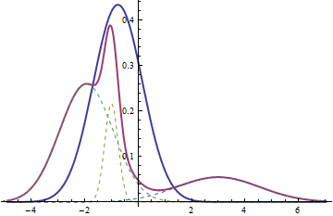
The iterative EM training process
What do we have now?
We can easily fit the Gaussians (estimate μ_{k} and Σ_{k}), if the responsibilities are given
We can easily calculate the responsibilities, if the Gaussians (μ_{k} and Σ_{k}) are given
We can turn it into an iterative process – the EM process

Slide 20
Steps of the iterative EM training process
0) Initialization of the μ_{k} and Σ_{k} values
e.g. randomly, or by K-means
1) (E step or Estimation step):
estimate the responsibilities
2) (M step or Maximization step):
maximize the log-likelihood of each Gaussian by re-calculating μ_{k} and Σ_{k}
GOTO 1)
μ_{k} and Σ_{k} changed, so we must re-calculate the responsibility values!

Slide 21
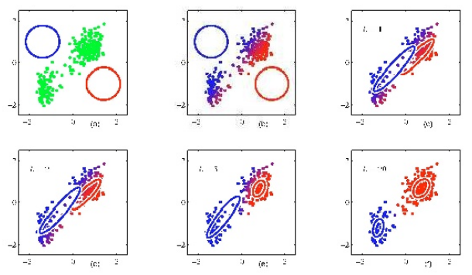
Example for EM

Slide 22
Alternative explanation
Remember that we tried to take the derivative of the log-likelihood of the mixture model, but we got stuck:
Notice that the problematic part is just the “responsibility”!
Let’s “cheat”, and act as if it was a constant, independent of μ_{k}!
Then we can calculate the derivative and get a new estimate for μ_{k} (and Σ_{k})
But what we obtained won’t be optimal, as we “cheated”
So we re-calculate the responsibilities and repeat the whole process again (and again and again and again)
This was the problem (it contains μ_{k})

Slide 23
Proof of the EM algorithm
What we described is possible, but how do we know that it converges to a reasonable solution?
We will now prove that each iteration step increases the log-likelihood value
So the full process is guaranteed to find a local optimum
The proof we be general, so it works not only for Gaussian mixture models, but for any model that has the form (finite mixture model):
(Notice that in the GMM the π_{k} weights were non-negative and add up to one, so we can interpret them as a discrete distribution P(k) )

Slide 24
Formalizing the maximization step
So far we optimized the Gaussians separately, i.e. we optimized the likelihood of for each Gaussian k
To represent the maximization step by one formula, we optimize the product of these likelihoods:
…from which we get the log-likelihood :
And remember that z_{nk} is the “probability” that sample x_{n} belongs to component k
In the following we will denote it as P_{θ}(k|x_{n}) :

Slide 25
Further notational modifications
Next we want to analize what happens in the maximization step
To discriminate the parameters before and after the maximization step, the actual parameters will be denoted by θ’, while the new parameters obtained by maximization will be θ
Our final goal is to maximize the log-likelihood:
But instead of this, in each iteration we maximize this:
So θ’ is fixed here, and θ is the variable (to be optimized)!

Slide 26
Expectation maximization
The function that we maximize in each iteration: …is also called the “expectation” function, because it is the conditional expectation of the function log P_{θ}(k,x_{n}) for a given x_{n} (training samples) and θ’
So, one iteration of te EM algorithm consists of to steps:
1) Expectation (or estimation) step: calculate the P_{θ’}(k|x_{n}) values fog a given θ’, as we need them for the above expectation
2) Maximization step: maximize the function with respect to θ

Slide 27
Proof of the EM algorithm
So, we want to maximize the log-likelihood:
But instead of this, we maximize:
(expectation)
We show that if the maximization step increased the value of the expectation function, so that for the actual θ’ and the new θ:
…then
That is, if the new expectation function is larger than the old one, then the new log-likelihood is also larger than the old one

Slide 28
Proof of the EM algorithm
So, we want to maximize the log-likelihood:
But instead of this, we maximize:
(expectation)
We show that if the maximization step increased the value of the expectation function, so that for the actual θ’ and the new θ:
…then
That is, if the new expectation function is larger than the old one, then the new log-likelihood is also larger than the old one

Slide 29
Proof (shortly)
The proof shows that
That is,
Because: if
then
Then, according to the proof,
Arranging this, we get

Slide 30
Summary – General properties of EM
It can be used to optimize any model that has the form
Instead of the log-likelihood function, it optimizes the expectation fuction
It is an iterative process
In each iteration, given the actual parameters θ’ , it finds a new parameter set θ for which the expectation is larger (not smaller)
It has two steps: expectation (or estimation) and maximization
It guarantees that the log-likelihood increases (does not decrease) in each step, so it will stop in a local optimum
The optimization formulas have to be derived for each model!

Slide 31
Some technical remarks
The parameters are usually initialized via K-means clustering
It may give quite different results depending to the initial choice of the centroids
So the clustering process is worth repeating with various initial choice (e.g. random choice) of the centroids
Then we start the EM process with the clustering result that gives the largest initial likelihood value
Of course, there exist more sophisticated methods to initialize the centroids
e.g. k-means++

Slide 32
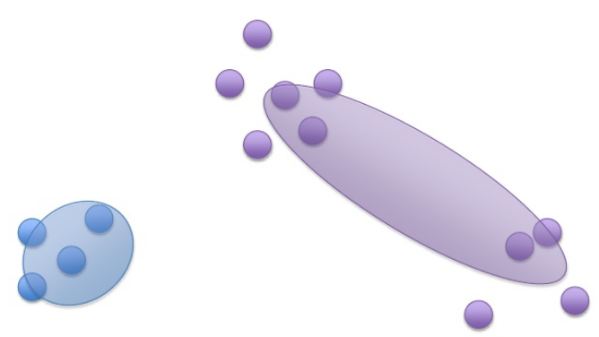
Technical remarks #2
We assumed that the number of Gaussians per class (meta-parameter K) was already determined
Is it possible to find the optimal value automatically?
The simplest solution is: try to use 1, 2, 3,… Gaussians
Chose the one that gives the largest likelihood
(aka. “grid search”)
What kind of error may occur if K is too small?
The algorithm finishes, but it gives a suboptimal solution

Slide 33
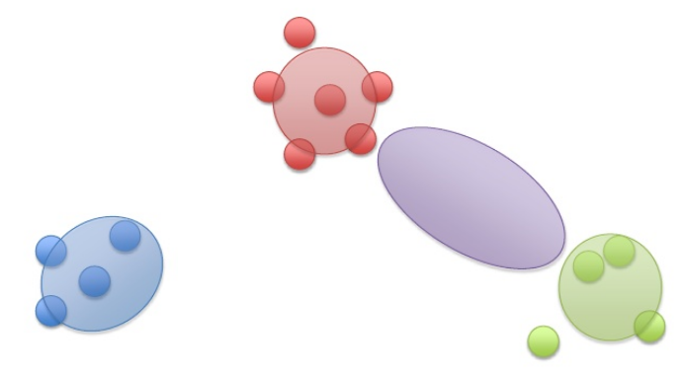
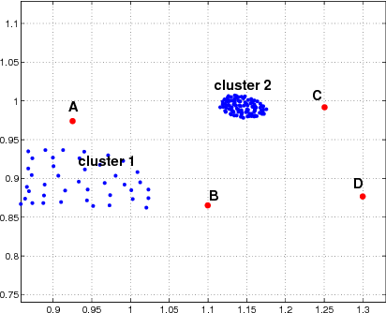
Technical remarks #3
What happens if K is too large?
One cluster or several clusters might become empty
But even if a cluster contains too few points might cause a problem
the covariance matrix becomes non-invertable:
…singularity problem
e.g.: what is the std. of one sample?
This makes the algorithm very sensitive to outliers

Slide 34
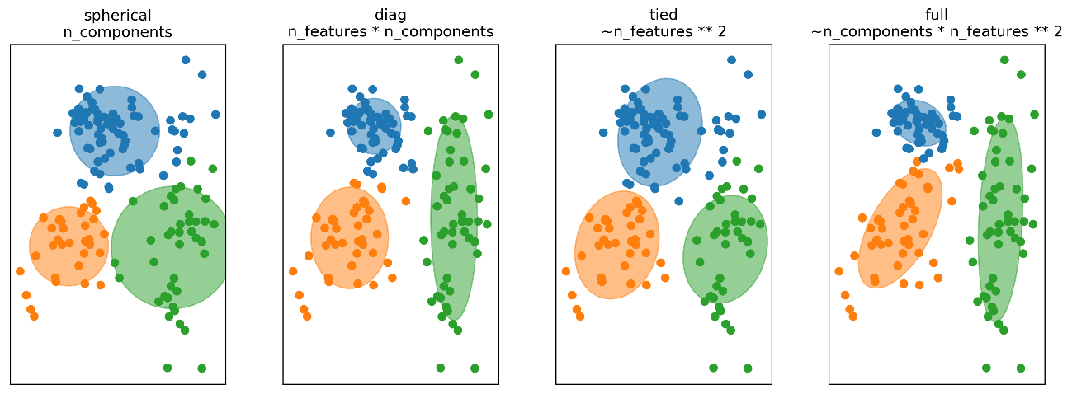
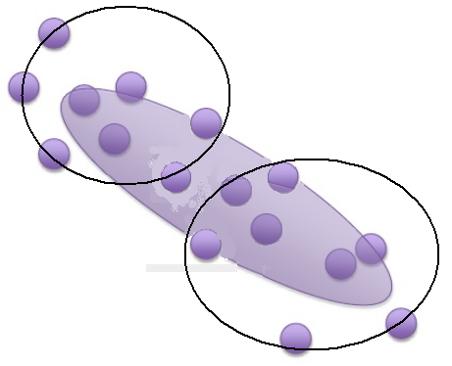
Technical remarks #4
In practice, we frequently restrict the Gaussian components to have diagonal covariance matrices
Singularity happens with a smaller chance
Computations becomes much faster
In each iteration we must re-estimate the covariance matrix and take its inverse – it is much faster with diagonal matrices
We can alleviate the model mismatch problem by increasing the number of Gaussian components

